Slide 1
We affect air quality. Air quality affects us.
Notes:
Hi my name is Bailey Doepker and I am and Environmental Educator for The City of Red Deer.
I get to go out to different classrooms and groups in Red Deer and talk about different environmental topics. I really enjoy my job because I love being outside and the environment and I find teaching about it lots of fun!
Before I begin I would like to thank Alberta Environment and Parks for the presentation – they have created most of it and I have added to it.
This presentation is meant to be interesting and interactive.
If you have any questions – “Please raise your hand so I can make sure everyone gets a chance.”
Today I have come to your classroom to talk about air. Air is very important because people need it to breathe, we can’t live without it! Air is also interesting because we all have an impact on air quality…so we affect air quality and in return air quality affects us.
Bring:
Worksheets
Magnets
Pencils
AQHI fortune teller sheets (and 1 built for show)
AQHI Poster for classroom

Slide 2
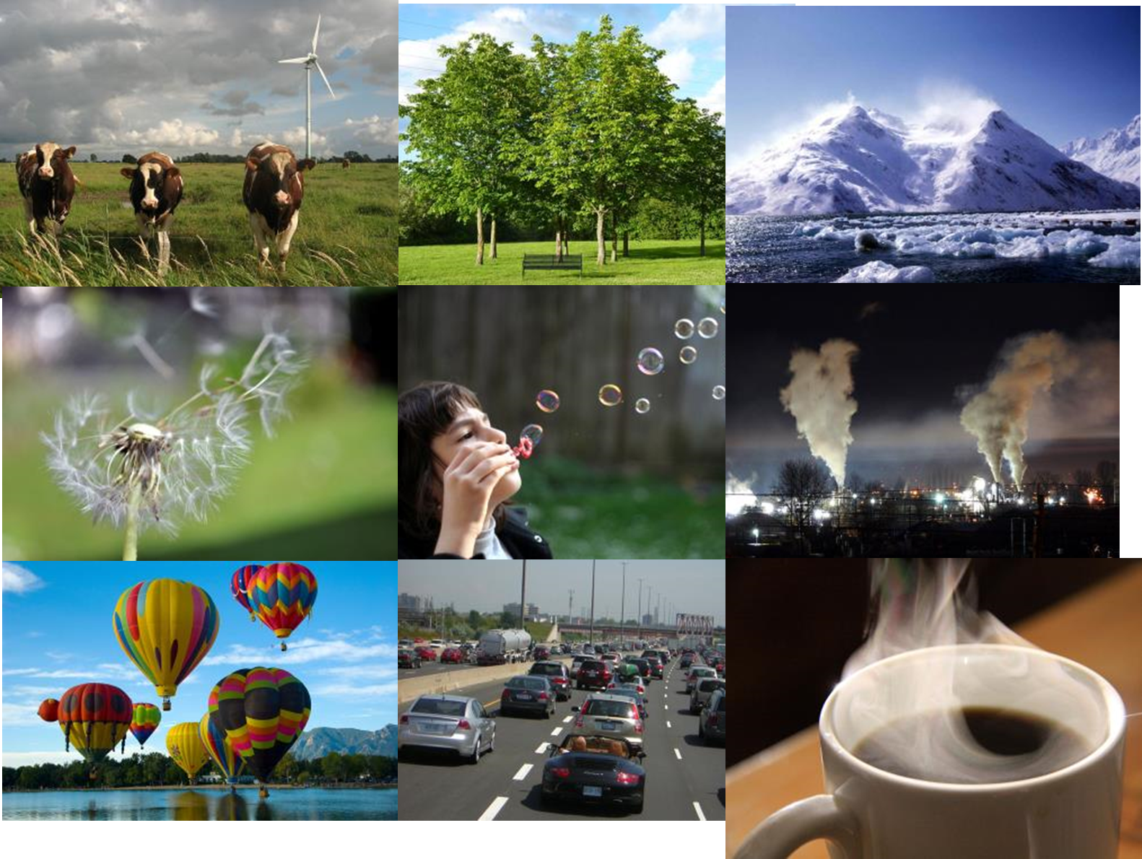
AIR
Notes:
Objective: Understand a student’s prior knowledge, think about air in different ways, be creative.
Question: What do you already know about air?
What can you tell me/teach me about air?
Air is…
Invisible, it’s odorless, it carries light, smell and sound, humans and animals need it to breathe, plants use it for photosynthesis, can move/blow seeds. Air can fill a container (balloon, bubble), wind is moving air, we can travel through it (airplanes, birds), it keeps the earth warm and protected, it can become polluted with other chemicals, etc.
Photosynthesis – process by which plants capture energy from the sun and use it to convert carbon dioxide and water into food
Air is a gas. Does anyone know what gasses make up air?
“What’s in Clean Air?” 78% nitrogen, 21% oxygen and 1% other gases
Most often we think of oxygen as being the biggest percentage because it’s a necessary gas for breathing. However, most of Earth’s air is made up of a gas called Nitrogen, which is also essential for life. When additional chemicals are added to this mix they change the quality of the air.
Nitrogen – odorless, colourless and tasteless. Nitrogen’s most important job is keeping plants and animals alive. This gas is critical to survival on Earth because it helps make the metabolic processes that transfer energy in cells possible. Plants at the bottom of the food chain help provide nitrogen for animals and humans who eat the plants.
Photos credits: commons.wikimedia.org and en.wikipedia.org
Dandelion - www.flickr.com/photos/murdomcd
Coffee - www.flickr.com/photos/waferboard

Slide 3
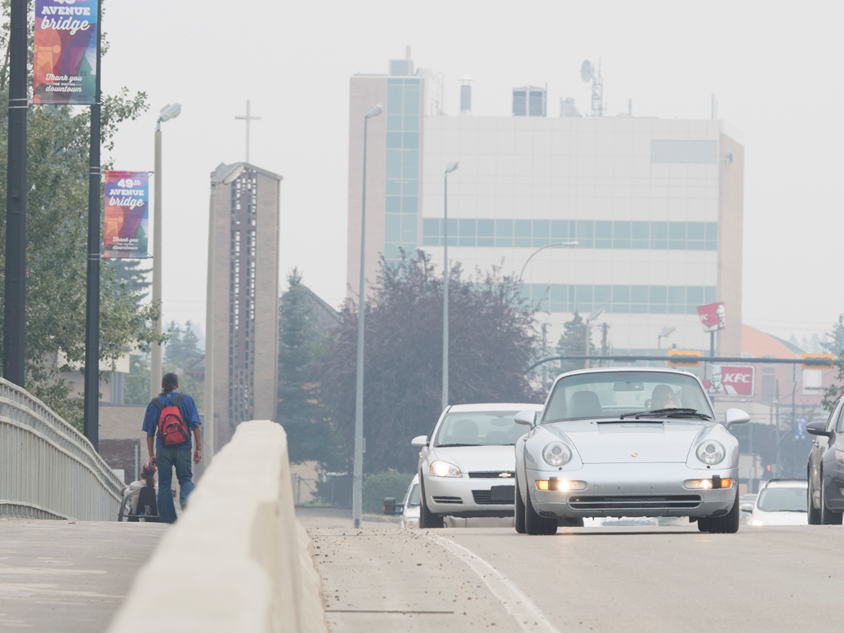
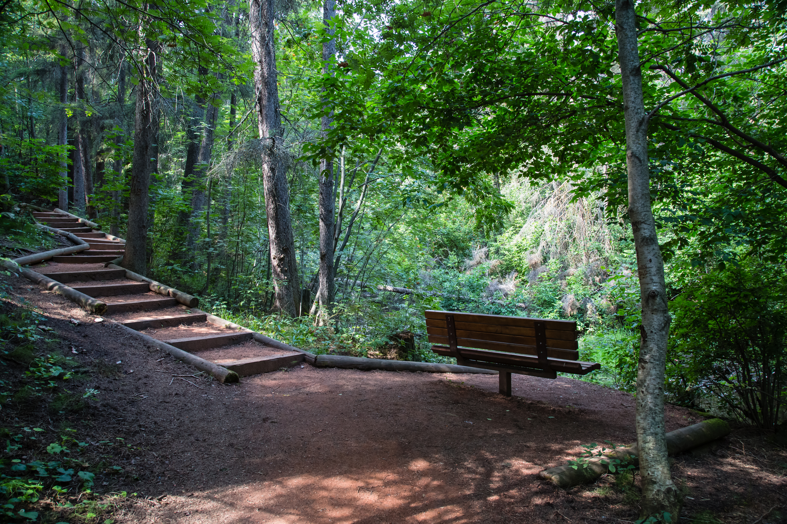
What is air quality?
Notes:
“What does “air quality” mean to you – what does it make you think of?”
Air quality is a measure of how good or bad the air is based on how much pollution is in it, or how it looks and smells (we’ll talk or focus today on outside air).
Have you ever noticed that the air smells different depending on where you are? For example, air in a city may smell different from air in the forest. That’s because there are different chemicals in the air. Sometimes chemicals are a result of human activities.
“How is our air quality in Red Deer?”
We enjoy very clean air in Red Deer – we rarely have poor air quality. Much better than large cities and other parts of the world.
This is largely a result of the number of people in our city, versus larger cities in China, US or Europe.
[short group discussion]

Slide 4
We affect air quality.
Notes:
“Did you know that we all affect air quality with the things that we do”
“What are some ways that people affect air quality (pollute the air outside)?
[WORKSHEET QUESTION]
-Vehicles: not all cars/trucks pollute the same – some cars pollute less than others
- also airplanes, motorcycles, lawn mowers
-campfires
-home heating/fireplaces use electricity or natural gas
-industry: agriculture and construction
Sometimes things make us more comfortable like driving cars, heating our homes and schools and using electricity – All of these create gases or emissions that pollute the air.
[brief discussion]

Slide 5
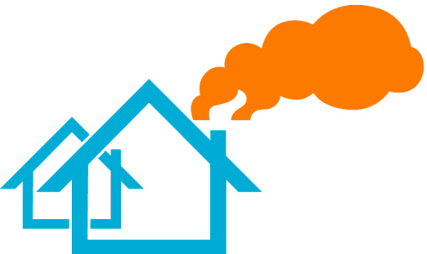
We affect air quality.
Notes:
“Most air pollution comes from burning fuel – could be gas used for cars or lawn mowers, fuel to run a factory or to make electricity, wood for heating or campfires, or heating our homes by furnaces or wood burning fire places”
“This shows that each one of us affects air quality.” As we all do one or more of the above activities.
[TAKE HOME MSG: We all affect air quality]
“Some air pollution is also natural – which means we can’t control it.”
(e.g., forest fires, dust, chemicals naturally release from trees, volcanoes, animals, even sloughs and swamps)
Trees release VOC’s

Slide 6
What can we do about it?
Notes:
“So we affect air quality. But we can make choices to protect the air quality outside” [WORKSHEET QUESTION]
Lots of the things we do will have an impact on air quality. Some things have an impact and we don’t have any other options to reduce our impact and still achieve the same result. But sometimes we have choices and we can make a choice to either eliminate or greatly reduce our impact by changing how we do things.
For example, we can drive our car everywhere (which has an impact) or we can make the choice to walk or ride our bicycle in order to eliminate our impact.
Another example, is light bulbs we all use the lights in our homes especially when the sun is not providing us with light. But we can make the choice to use more efficient bulbs like LEDs that require less energy. More specifically a typical incandescent bulb will use about 60W of energy and an equivalent LED bulb will use only about 7W. Because the LED bulb uses less electricity it will also cost less to operate. The incandescent bulb will cost about $169 and the LED bulb will cost only about $30 for electricity over the same time period.
So many activities can help improve the air quality - Walking or riding bike, carpooling, taking the bus, reducing the energy we use (turning off lights when not in use), planting trees.
[If time permits can ask for other suggestions]

Slide 7
What are some ways weather affects air quality?
Notes:
“In your Science class you are learning about weather”
“Did you know that weather affects air quality?” (can change it)
“What are some ways that weather can affect air quality?”
[WORKSHEET QUESTION]
Wind can move pollution around, mixing it, which stops pollution from building up.
An airshed is an area where the movement of air, and air pollutants, can be hindered by local geographical features such as mountains, and by cold weather conditions. Red Deer is located in the Parkland Airshed Management Zone.
Rain removes pollution from the air (so does snow) – [may get a comment on acid rain]. Precipitation (rain and snow) can bring air pollution down to Earth making land and water pollution.
Air Pollution – is caused by solid and liquid particles and certain gases that are suspended in the air. These particles and gases can come from car and truck exhaust, factories, dust, pollen, mold spores, volcanoes and wildfires. The solid and liquid particles suspended in our air are called aerosols.
Acid Rain – results when SO2 and NOx are emitted into the atmosphere and transported by wind and air currents. The SO2 and NOx react with water, oxygen and other chemicals to form sulfuric and nitric acids. These then mix with water and other materials before falling to the ground. (SO2 and NOX - a small portion may come from natural sources but most of it comes from burning of fossil fuels for electricity, vehicles and heavy equipment, manufacturing, oil refineries and other industries)
The sun can bake molecules in the air and make pollution, OR the sun can change chemicals in the air like a Transformer. Example – ground level ozone is created when sunlight reacts with certain chemicals that come from sources of burning fossil fuels like factories and car exhaust. (Further when particles in the air combine with ozone they create smog – which is a type of air pollution that looks like smoky fog and makes it difficult to see).
Temperature also has an impact on air quality. Temperature can create something called an air inversion. Normally we have warm air near the surface which rises and cools. But with an inversion we have cool air near the surface with warm air above, this warm air prevents the cool air from rising and stops the pollution from mixing or blowing around.
Ozone – as air pollution – ozone in cities is a major cause of air pollution. Ozone is a greenhouse gas and it can be both good and bad for our environment depending on where it is. Ozone close to the ground is bad ozone but a bit farther out is good ozone (it protects us from the sun).

Slide 8
Weather affects air quality
WIND
Notes:
“Wind moves pollution around and spreads it out through mixing.”
“When winds are very calm, pollution doesn’t move and can build up in one area.”
(like adding salt to soup - stirring it in mixes the salt all around and spreads it out, whereas eating a spoon of salt is disgusting)
Wind can move pollution very long distances.
Did you know that some air pollutants found in remote areas of Nunavut (way up North) can be traced back to power plants in the U.S. & Mexico.

Slide 9
Air quality affects us.
Notes:
“So…..we affect air quality, and the weather affects air quality
but air quality also affects us”
“We need air to breathe.”
“You could go days without food and hours without water, but you would last only a few minutes without air”
Don’t expand - move to next slide for activity….

Slide 10
Breathe Easy Experiment
Notes:
“What is it like if you can’t breathe well?” “Has anyone had that experience?”
[makes it hard to do things, etc.]
“We’re going to do a science experiment on breathing to see what it feels like to breathe in different conditions.”
“Before we start we are going to hypothesize. What is a hypothesis?”
Hypothesis – explanation bases on limited evidence as a starting point for a further investigation.
[BREATHING ACTIVITY GUIDE – likely 20 minutes]
[ask teacher first if there are any children with asthma that may have trouble with this activity]
Form your lips in a small circle and try to breathe normally
After activity – reiterate: AIR QUALITY AFFECTS US
“What happened?” “Were your hypotheses correct”
“How did if feel breathing through the smaller air hole compared to normal breathing?”
“What changed after you exercised?” – mention that everyone is different (some people may not notice)
“How might air pollution in the air outside affect our breathing?”
“How might air pollution outside affect someone with asthma?”
Both air pollution and asthma make it more difficult to breathe it can feel more like this.

Slide 11
Some other ways air quality can affect our health
tight chest
itchy eyes
scratchy / sore throat
stuffy nose
trouble breathing
coughing
wheezing
smell an odour
Notes:
“So bad air quality can make it hard to breathe
what are some things you might feel or notice when the air outside is polluted?”
[WORKSHEET QUESTION #1]

Slide 12
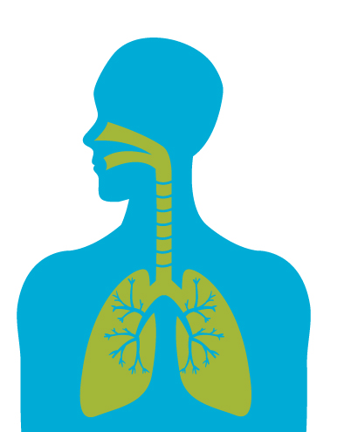
What does this mean for you and me?
Fine particles
2 micrometers
Human hair
70 micrometers
Notes:
“So air quality affects us.” “We need air to breathe.”
“But we can’t always see pollution in the air.”
“One pollutant that affects our health, but we may not see, is particulate matter – small particles in the air.”
Activity: Take a few deep breathes. Can you feel your rib cage moving in and out? Why is breathing so important? We need to breathe to survive - Our lungs take in oxygen which moves around your body in your blood. This oxygen in the air keeps you alive.
“Our body’s are pretty good at filtering out particles as we breathe – large particles are removed by coughing, sneezing or swallowing.”
“But some particles are very tiny – tiny enough to get into our lungs.”
These tiny particles are microscopic particles about 30 times smaller than hair and invisible to the human eye.
Bad air quality can make it hard to breathe, irritate our nose and throat, sting our eyes and make it very difficult for people with asthma, babies and older people.
What happens if these microscopic particles float through the air?
Particles enter the nose and mouth – causing irritation
These particles are breathed in
Larger particles are removed by coughing, sneezing, and swallowing
Small particles can go deep into the lungs
[CLICK to bring up image of PM2.5]
[compare size of our hair (70 micrometers) to fine particulate matter (~ 2 micrometers)]

Slide 13
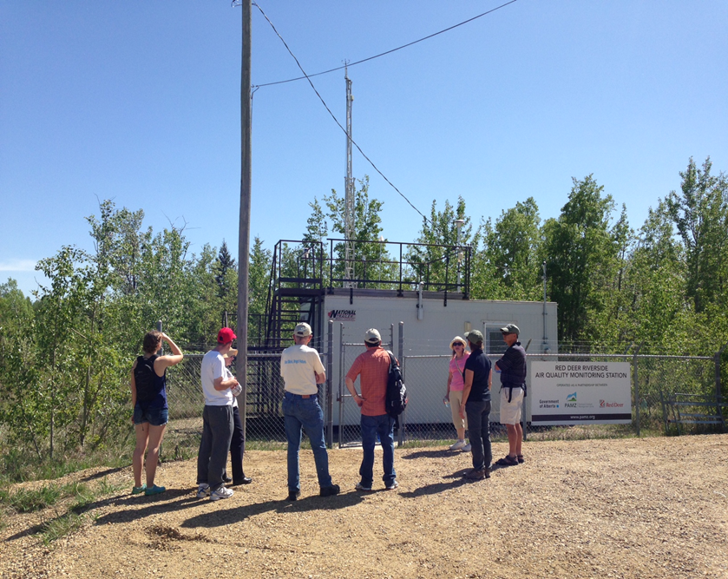
What is in the air?
Air Monitoring Stations
2 stations in Red Deer
Notes:
“If we can’t always see pollution, how do we know what is in the air?”
The photo is of the air monitoring station on Riverside Drive near Three Mile Bend and the second station is in Lancaster around 30th Avenue and Lancaster Drive.
“Air scientists measure pollution in the air and report on whether it is good or bad.”
[measure what pollution is in the air and how much]
SCIENTISTS monitor the air and report
-Particulate matter (tiny particles in the air) – diesel fumes
-Sulfur dioxide – coal and oil power plants
-Nitrogen dioxide – combustion of fossil fuels, oil refinery, industrial processes
-Carbon monoxide – motor vehicles
-VOCs – glue, paring, gasoline, dry cleaning, cigarettes
“This is a picture of an air monitoring station. The scientists for the Parkland Airshed Management Zone measure air quality and weather here”.
“For weather we measure things like temperature, wind speed, wind direction, moisture in the air.”
[can point out the wind instruments on the tower]
[air quality instruments are inside, can expand if time permits]

Slide 14
Air Quality Health Index
Notes:
“This is the Air Quality Health Index.” “Has anyone heard of it?”
“This is how we can measure how air quality outside might affect our health.”
“It has numbers from 1 to 10 like the UV Index.”
BRIEFLY explain scale – the lower the number the lower the risk to health
OR the higher the number the more pollution in the air, the higher the health risk
“What do you notice about the colors in the scale?” “How do they change?”
We know that air pollution can affect human health so it’s good to be aware of the air quality in your community.

Slide 15
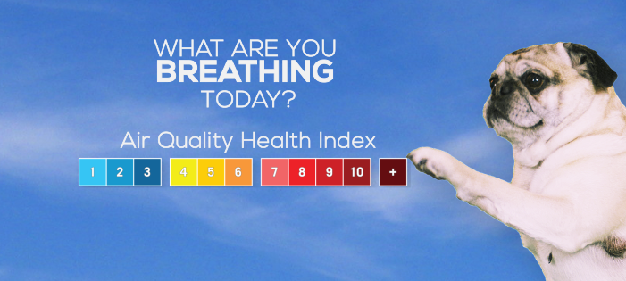
Air Quality Health Index Video
Notes:
“Here is a video explaining more about the Air Quality Health Index and how air quality affects us”
Video is approx. 1 minute long.
“So we can use the Air Quality Health Index to know how the air quality is outside before we go out to play or exercise.”
Video link - https://www.youtube.com/watch?v=8lfiZGNxcZQ

Slide 16
What can we do about it?
EVERYONE
can check the Air Quality Health Index
airquality.alberta.ca
Notes:
“So air quality affects us. What can we do about it?”
Everyone can check the Air Quality Health Index to see what kind of air day it is, just like checking the weather.
“Do you remember this scale we looked at earlier?” “It has numbers that go from 1 to 10.”
Describe what the categories mean – what you might notice
[1-3 -- good, normal]
[4-6 -- pollution build up, smog – may not notice just by looking outside]
[7+ -- you would probably see and feel a difference, e.g. forest fire smoke]
“There is a website where you can check the AQHI”
[CLICK LINK to open website – will take you away from presentation]
“You can also download the AQHI Canada app?”
Learn what the air around you means to your health. Have the app and have access to this information at any time.

Slide 17
What can we do about it?
Examine your school’s air quality habits:
Reduce your electricity use
Use different forms of transportation
Start an idle free education campaign
Reduce, reuse, recycle
Avoid using chemical products
Reduce the school’s heat loss
Notes:
Explore ways students can take on simple air quality action projects.
We know that we have the ability to add pollution into the air. So how can we reduce our emissions or pollution?
Consider whether your school is thinking about it, has a plan in place or is already doing it.
-Reduce electricity use – turn off or unplug lights, electronics, use energy efficient light bulbs
-Use different forms of transportation – walk or bike to school, carpool, bus or use public transit
-Start an idle free education campaign – see The City of Red Deer’s idle free school manual
-Reduce, reuse, recycle – paper, drink containers, craft supplies, litter free lunch
-Avoid using chemical products – natural cleaners, environmentally friendly yard products
-Reduce the school’s heat loss – lower the thermostat by 1 degree, host a fun sweater day, cover windows at night, find drafts and block them
Are you inspired to start your class’ air quality awareness campaign?
Congratulations! You are developing good air quality habits.

Slide 18
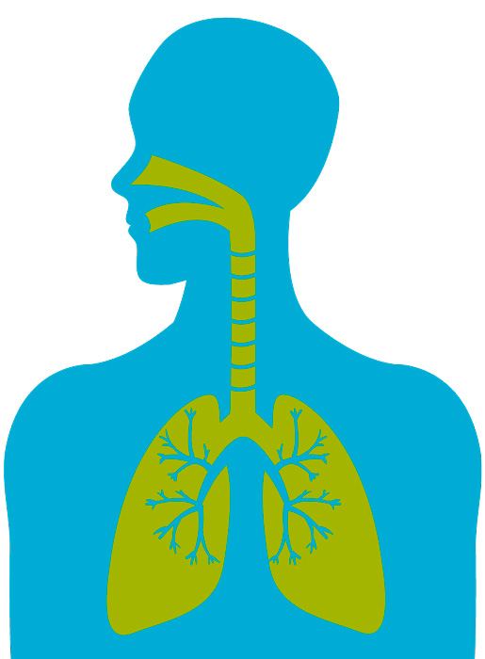
Air quality affects us.
We affect air quality.
Notes:
Reiterate take-home message.

Slide 19
LET’S PLAY A GAME!
Play the Air Quality Jeopardy Game
Notes:
Air Quality Jeopardy Game
[16-square game should be a good length, or 25-square for a longer presentation]
Try to finish game with about 5 minutes left over for questions and handing out materials.

Slide 20
We can’t live
without it!
Earth
Matters
Wise
Choice
Child’s
Play
1 point
1 point
1 point
1 point
2 point
2 point
2 point
2 point
3 point
3 point
3 point
3 point
4 point
4 point
4 point
4 point
Notes:
Mention that questions get more difficult as the point value increases
Key Questions to get through:
Green or Brown 2pt (slide 14) – what impacts air quality
It’s off to work we go 5 pt (slide 30) – use index to change behaviour
Child’s Play 2 pt (slide 34) – children outside
Child’s Play 3 pt (slide 36) – children breathe more

Slide 21
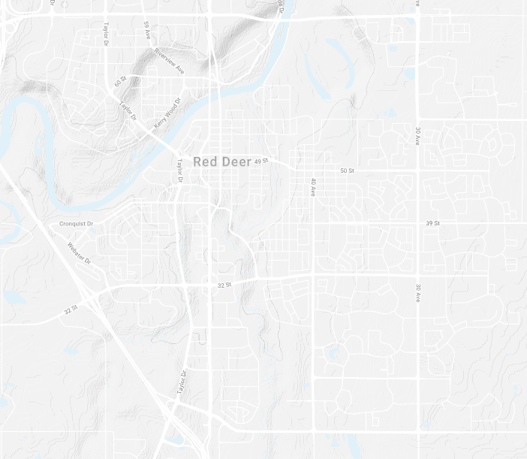
Measuring Air Quality
Notes:
Objective: understand that air quality is measured. The information gathered through measuring is important when making decisions.
We talked about the air quality monitoring stations located in the city and how the information gathered is important in making decisions. Now we are going to try to understand air quality a bit better by measuring air quality ourselves.
Introduce the Airbeam…
You can measure air quality too. The air beam measures temperature, humidity and fine particulate matter (PM2.5). Sound levels can also be recorded. These measures can be recorded and saved on the AirCasting map.
We are now going to head outside to do a testing experiment.

Slide 22
THANK YOU!
Do you have questions?
Learn what the air around you means to your health!
airquality.alberta.ca

